Slide 1
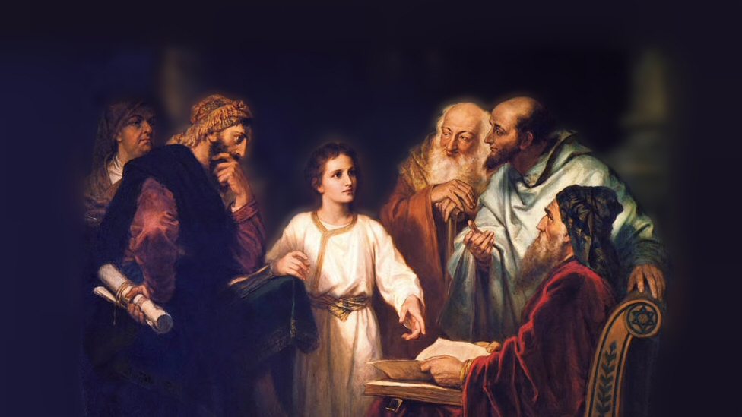
About My Father’s Business
Zacchaeus
(Luke 19:1-10)
Notes:
(Luke 19:1-10) READ
Many lessons to be learned from this text
Note: Jesus’ willingness to go to the house of a Publican was scandalous to the Jewish leaders.
When Jesus dined in Matthew’s house (a publican) many other publicans and sinners were present. Scribes and Pharisees, “How is it that He eats and drinks with tax collectors and sinners?” (Mark 2:16).
(Mark 2:17), “When Jesus heard it, He said to them, “Those who are well have no need of a physician, but those who are sick. I did not come to call the righteous, but sinners, to repentance.”
OUR VERSE 7, “When Jesus heard it, He said to them, “Those who are well have no need of a physician, but those who are sick. I did not come to call the righteous, but sinners, to repentance.”
Zacchaeus was a penitent man
Because of this, he received forgiveness from the Lord
We want to consider some lessons about overcoming barriers that can be seen from the example of Zacchaeus
Picture attribution: More Good Foundation (cropped, with background blurred) Creative Commons Liscense. https://www.flickr.com/photos/moregoodfoundation/5135438113

Slide 2
Overcoming Barriers
First Barrier: A Bad Reputation (7)
1 Peter 2:11-12; Matthew 13:22
Notes:
The First Barrier: A Bad Reputation
Not being popular with the people, Zaccheus had to overcome the barrier of his reputation.
Perhaps there was some justification for the ill-will on the part of the Jews from whom the taxes were collected. Nevertheless, the barrier was there.
He must overcome that to see Jesus. He would not let what others think of him as a person keep him from seeing the Lord.
Jesus’ attitude here was commendable. He was not afraid of what the Jews would think.
It is important to guard our reputation. But, we do so not by being concerned about what others will do or say, rather by making sure they have no JUST cause to criticize.
(1 Peter 2:11-2), “Beloved, I beg you as sojourners and pilgrims, abstain from fleshly lusts which war against the soul, ¹² having your conduct honorable among the Gentiles, that when they speak against you as evildoers, they may, by your good works which they observe, glorify God in the day of visitation.”
A worry about how we will be perceived by others can’t be allowed to keep us from serving Him!
(Matthew 13:22), “Now he who received seed among the thorns is he who hears the word, and the cares of this world and the deceitfulness of riches choke the word, and he becomes unfruitful.”

Slide 3
Overcoming Barriers
First Barrier: A Bad Reputation (7)
1 Peter 2:11-12; Matthew 13:22
Second Barrier: Riches (8)
Mark 10:21-22; Matthew 13:22
Notes:
The Second Barrier: Riches
One of the greatest evils of the Lord's people today is materialism.
Zacchaeus was rich, but still he was determined to see Jesus; he would not let this (as is shown in verse 8) hinder him.
Yet today, we see thousands of Christians letting material things hinder them
A contrast may be drawn between Zacchaeus and the rich man of Mark 10:21ff.
(Mark 10:21-22), “Then Jesus, looking at him, loved him, and said to him, “One thing you lack: Go your way, sell whatever you have and give to the poor, and you will have treasure in heaven; and come, take up the cross, and follow Me.” ²² But he was sad at this word, and went away sorrowful, for he had great possessions.”
Why are riches so hard to overcome? First, because they bind us to this life. Secondly, they tempt us to gather more wealth, trusting in that rather than spending precious time in the Lord's service. Thirdly, they are a hindrance because they promise luxury, popularity and status, all of which is so fleeting.
We need to see how riches deceive! (Our minds too caught up in materialism, and the selfish desire to maintain what is ours). We do not give as we should. We do not focus on spiritual affairs above the material concerns!
(Matthew 13:22), “Now he who received seed among the thorns is he who hears the word, and the cares of this world and the deceitfulness of riches choke the word, and he becomes unfruitful.”

Slide 4
Overcoming Barriers
First Barrier: A Bad Reputation (7)
1 Peter 2:11-12; Matthew 13:22
Second Barrier: Riches (8)
Mark 10:21-22; Matthew 13:22
Third Barrier: The Crowd (3-4)
Matthew 5:13; 2 Kings 22:1-2
Notes:
The Third Barrier: The Crowd
Since he was little, the crowd got in his way.
It is ironic that often those who also want to see Jesus get in the way of others.
They don't mean to do so, but with their careless lives and hypocrisy (like the Jews in Jesus' day), they hinder others from seeing Jesus.
May we never be an impediment to those who seek the Lord by our own failings, lack of love, lack of friendliness.
(Matthew 5:13), “You are the salt of the earth; but if the salt loses its flavor, how shall it be seasoned? It is then good for nothing but to be thrown out and trampled underfoot by men.”
(Interesting, conversation on Facebook about River Oaks churches. Man had gone to several, no one spoke to him! Visit with others AFTER visitors are gone. Make an effort to welcome others!)
Also, commendable when one comes to Christ DESPITE all the obstacles that others may throw at them. (Family, friends, upbringing).
(2 Kings 22:1-2), “Josiah was eight years old when he became king, and he reigned thirty-one years in Jerusalem. His mother's name was Jedidah the daughter of Adaiah of Bozkath. ² And he did what was right in the sight of the Lord, and walked in all the ways of his father David; he did not turn aside to the right hand or to the left.”
Despite Manasseh (Grandfather) and Amon (Father)
Remember, Zacchaeus was not too dignified to climb a tree to see Jesus. We need to remember what is important, and let nothing get in the way of seeing the Lord.

Slide 5
Overcoming Barriers
First Barrier: A Bad Reputation (7)
1 Peter 2:11-12; Matthew 13:22
Second Barrier: Riches (8)
Mark 10:21-22; Matthew 13:22
Third Barrier: The Crowd (3-4)
Matthew 5:13; 2 Kings 22:1-2
Fourth Barrier: Physical Size (3)
1 Timothy 4:12; Luke 21:1-4; Mark 14:6-9
Notes:
The Fourth Barrier: Physical Size
Because Zacchaeus was small, he had to find a way to overcome this. He climbed up into the tree.
Today many have physical handicaps, and some let them hinder, and some do not.
Sometimes racial or ethnic backgrounds serve as a hindrance, if we let them.
Sometimes one’s age may be considered a drawback or handicap, if we let them.
(1 Timothy 4:12), “Let no one despise your youth, but be an example to the believers in word, in conduct, in love, in spirit, in faith, in purity.”
Sometime the handicap may be economic, it we let it be.
(Luke 21:1-4), And He looked up and saw the rich putting their gifts into the treasury, ² and He saw also a certain poor widow putting in two mites. ³ So He said, “Truly I say to you that this poor widow has put in more than all; ⁴ for all these out of their abundance have put in offerings for God, but she out of her poverty put in all the livelihood that she had.”
Consider Mary, Jesus’ friend. She anointed his head with oil. Some were indignant.
(Mark 14:6-9), “But Jesus said, “Let her alone. Why do you trouble her? She has done a good work for Me. ⁷ For you have the poor with you always, and whenever you wish you may do them good; but Me you do not have always. ⁸ She has done what she could. She has come beforehand to anoint My body for burial. ⁹ Assuredly, I say to you, wherever this gospel is preached in the whole world, what this woman has done will also be told as a memorial to her.”

Slide 6
Conclusion
Salvation can come to your house today if you overcome any barriers you might have, and determine to see the Lord!
(Acts 8:36-38)
Notes:
(Acts 8:36-38), “Now as they went down the road, they came to some water. And the eunuch said, “See, here is water. What hinders me from being baptized?” ³⁷ Then Philip said, “If you believe with all your heart, you may.” And he answered and said, “I believe that Jesus Christ is the Son of God.” ³⁸ So he commanded the chariot to stand still. And both Philip and the eunuch went down into the water, and he baptized him.”

